Slide 1



DATA COMMUNICATION & COMPUTER NETWORK (DCCN)
[CS221] [Cr:3]
Dr. Jyoti Prasanna Patra
Jyotiprasanna.patra@cgu-odisha.ac.in

Slide 2
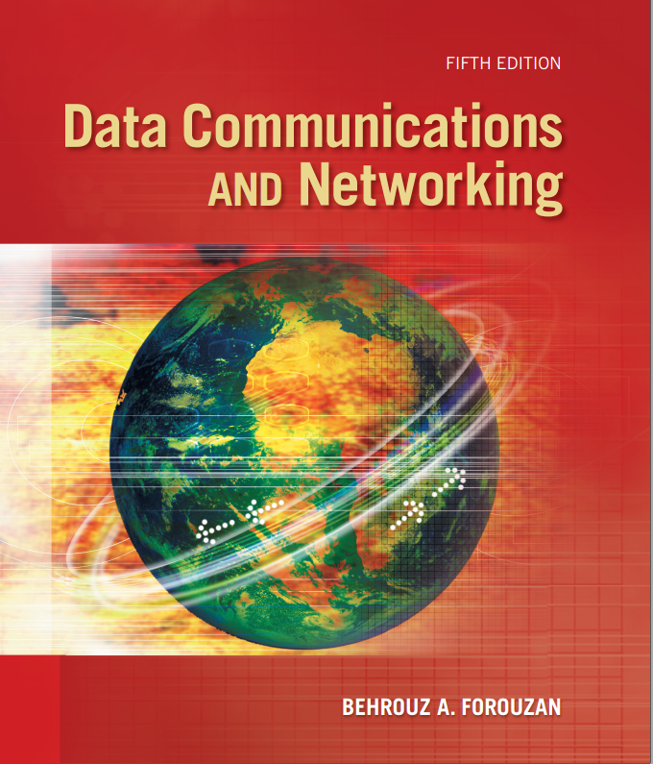
Syllabus
Unit-1: Data Communication Fundamentals [8 Hrs]
Overview of Data Communications, Fundamentals of Network, Network Topologies, Services, Standardization, Reference Models: OSI Model, TCP/IP Model.
Physical Layer: Analog and Digital Signals, Data Rate Limits, Transmission Impairment, More about signals. Digital Transmission: Line coding, Sampling, Transmission modes.
Unit-2: Modulation and Switching Techniques [8 Hrs]
Analog Transmission: Modulation of Digital Data, Modulation of Analog signals. Multiplexing: FDM, WDM, TDM, Transmission Media: Guided Media, Unguided Media, Circuit Switching and Packet Switching.

Slide 3
Syllabus
Unit-3: Data Link Layer [8 Hrs]
Error Detection and Correction: Types of Errors, Detection, Error Correction.
Data Link Control and Protocols: Flow and Error Control, Stop-and-wait ARQ, Go-Back-N ARQ, Selective Repeat ARQ, HDLC, PPP.
Multiple Accesses: Random Access, Controlled Access, Channelization. Local area Network: Standard Ethernet, Wireless LANs: IEEE 802.11.
Unit-4: Network and Transport Layer: [6 Hrs]
Host to Host Delivery: Internetworking, Addressing and Routing, Network Layer Protocols: ARP, IPV4, ICMP, IPV6,
Transport Layer: Process to Process Delivery: UDP, TCP, Congestion Control. Routing Protocols: AODV, DSDV, DSR.
Unit-5: Application Layer: [6 Hrs]
Client Server Model, Socket Interface, Domain Name System (DNS): Electronic Mail (SMTP), File Transfer (FTP), POP, Remote Logging, HTTP and WWW.

Slide 4
Text / References Book
Text Books
T1: Data Communications and Networking: Behrouz A. Forouzan, Tata McGraw-Hill, 4th Edition.
T2: Computer Networks: A. S. Tannenbum, D. Wetherall, Prentice Hall, Imprint of Pearson 5th Edition.
References Books
R1: Computer Architecture and Parallel Processing”, Hwang and Briggs, Tata McGraw Hill Publication,
R2: Data and Computer Communications: William Stallings, Prentice Hall, 9thEdition.

Slide 5
Websites References
  https://www.youtube.com/watch?v=sG6WGvzmVaw
  https://www.javatpoint.com/computer-network-introduction
  https://www.geeksforgeeks.org/basics-computer-networking/
  https://www.tutorialspoint.com/computer_fundamentals/computer_networking.htm
  https://nptel.ac.in/courses/106/105/106105081/
  https://www.classcentral.com/course/swayam-computer-networks-13951
  https://www.coursera.org/courses?query=computer%20network

Slide 6
Course outcomes
CO1 | Understand the fundamental principles of Data communication and Computer Networking.
CO2 | Analyze different features of analog and digital transmission.
CO3 | Analyze the working principles and protocols of data link layer.
CO4 | Identify and differentiate working principles and protocols of network and transport layer.
CO5 | Identify and implement different types of application in application layer

Slide 7
Data Communication and Computer Networks

Slide 8
DATA COMMUNICATIONS
The term telecommunication means communication at a distance.
The word data refers to information presented in whatever form is agreed upon by the parties creating and using the data.
Data communications are the exchange of data between two devices via some form of transmission medium such as a wire cable.
Fundamental Characteristics:
Delivery, Accuracy, Timeliness, Jitter

Slide 9
Fundamental Characteristics
  Effectiveness of data communication system depends on
  Delivery: The system must deliver data to correct destination.
  Data received by the intended user only
  Accuracy: The system must deliver data accurately (no change).
  Data changed & uncorrected is unusable
  Timeliness: The system must deliver data in timely manner
      Data arrived late are useless
      In the same order (video and audio) & without delay (Real time transmission)
      Jitter: Variation in the packet arrival time (uneven quality in the video is the result)

Slide 10
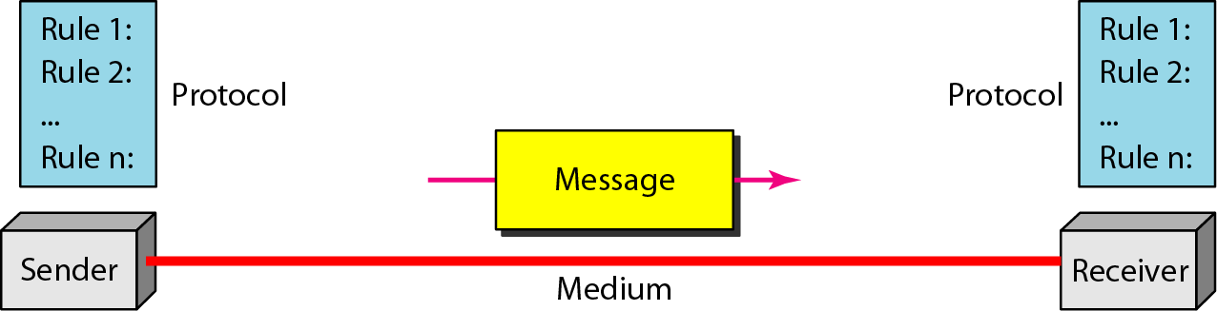
Five components of data communication
Components
Message,
Sender,
Receiver
Transmission Medium
Protocol

Slide 11
Components of Data Communication
  Message: The message is the information (data) to be communicated.
  Examples: Text, numbers, pictures, audio, and video
  Sender: The sender is the device that sends the data message.
    Examples: Computer, workstation, telephone handset, video camera, and so on
  Receiver: The receiver is the device that receives the message.
    Examples: Computer, workstation, telephone handset, television, and so on
  Medium: The transmission medium is the physical path by which message travels
  from sender to receiver.
  Examples: Twisted-pair wire, coaxial cable, fiber-optic cable and radio waves.
  Protocol: Set of rules that governs data communications. It represents an agreement
  between the communicating devices. Without a protocol, two devices may be
  connected but not communicating.

Slide 12
Data Flow
Communication between two devices can be
simplex,
half-duplex,
full-duplex

Slide 13
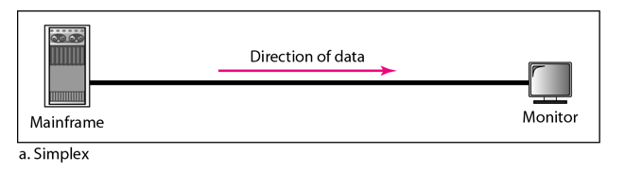
Simplex Mode
In simplex mode, the communication is unidirectional. Only one of the two devices on a link can transmit; the other can only receive.
The simplex mode can use the entire capacity of the channel to send data in one direction.
Examples: Keyboards and traditional monitors.

Slide 14
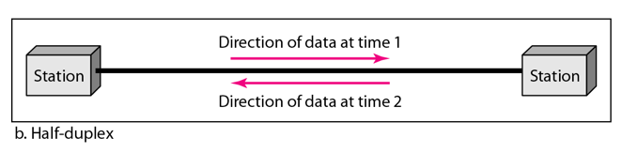
Half-Duplex Mode
In half-duplex mode, each station can both transmit and receive, but not at the same time.
When one device is sending, the other can only receive, and vice versa.
The entire capacity of a channel is taken over by the transmitting device
  Example: Walkie-talkies

Slide 15
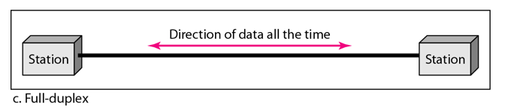
Full-Duplex Mode
In full-duplex mode (also called duplex), both stations can transmit and receive simultaneously
The capacity of the channel is divided between signals traveling in both directions
Example: Telephone network

Slide 16
NETWORKS
A network is a set of devices (often referred to as nodes) connected by communication links.
Node: A node can be a computer, printer, or any other device capable of sending and/or receiving data generated by other nodes on the network.
  Links: Communication pathway that transfers data from one device to another. Ex: Cable, air, optical fiber etc
Topics discussed in this section:
Network Criteria
Physical Structures
Categories of Networks

Slide 17
Network Criteria
  Performance can be measured in many ways, including transit time and response time.
    Throughput
    Delay
  Reliability is measured by the frequency of failure, recovery, and robustness.
  Security issues include protecting data from unauthorized access.

Slide 18
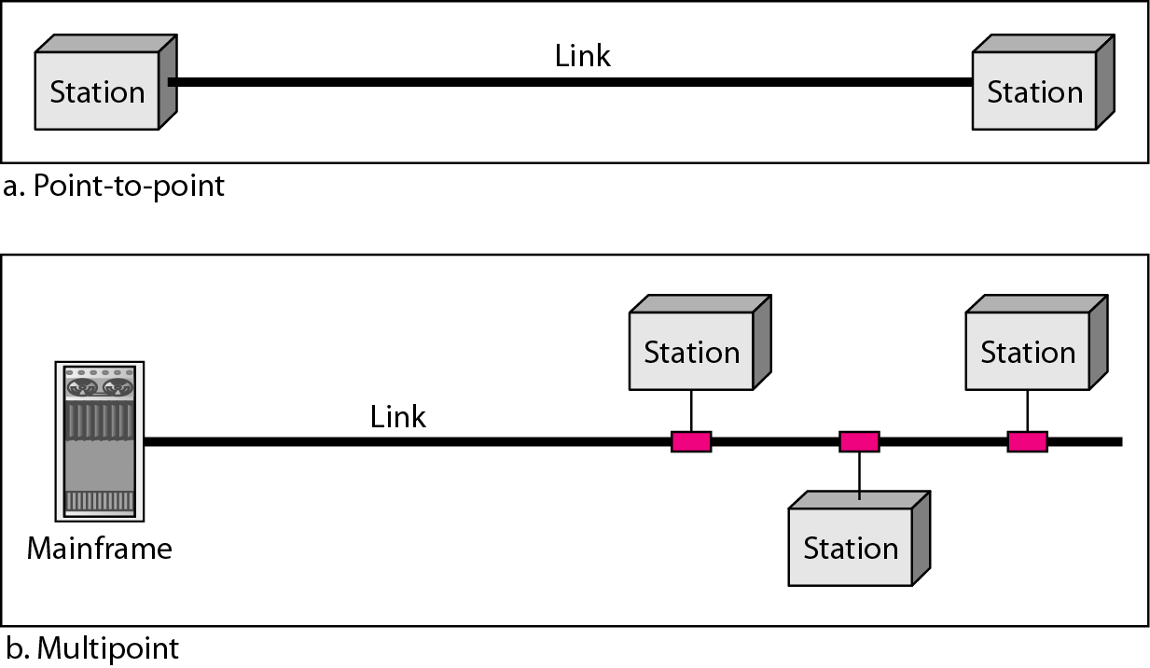
Types of connections: point-to-point and multipoint
A point-to-point connection provides a dedicated link between two devices.
A multipoint connection is one in which more than two specific devices share a single link.
In a multipoint environment, the capacity of the channel is shared, either spatially or temporally.
If several devices can use the link simultaneously, it is a spatially shared connection. If users must take turns, it is a timeshared connection.

Slide 19
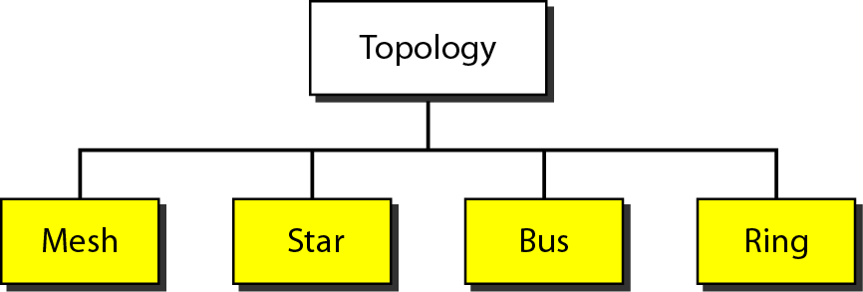
Physical Topology
The topology of a network is the geometric representation of the relationship of all the links and linking devices (usually called nodes) to one another.
There are four basic topologies possible: mesh, star, bus, and ring.

Slide 20
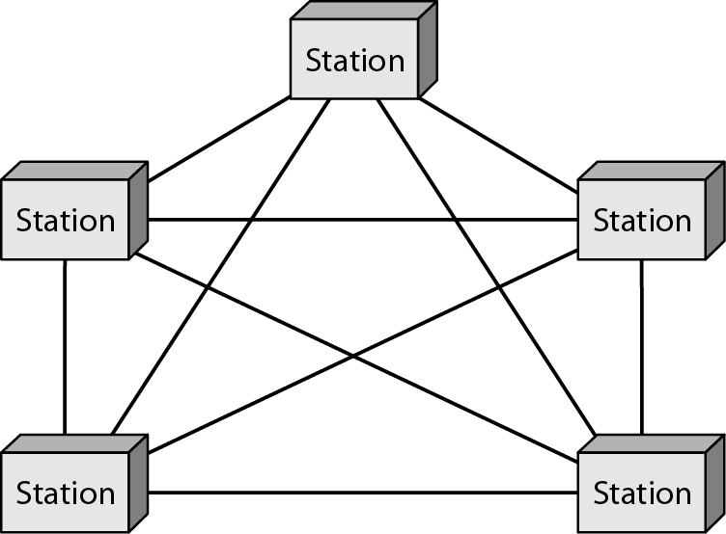
Mesh Topology
.
In a mesh topology, every device has a dedicated point-to-point link to every other device.
  # Cables = n (n – 1) / 2 (No. of duplex mode)
  # ports= n (n-1)
Advantages:
  Minimum traffic problems
  Robustness
  Security
  Easy fault identification
Disadvantages: Amount of cabling and the number of I/O ports required.
An application: connection of telephone regional offices.

Slide 21
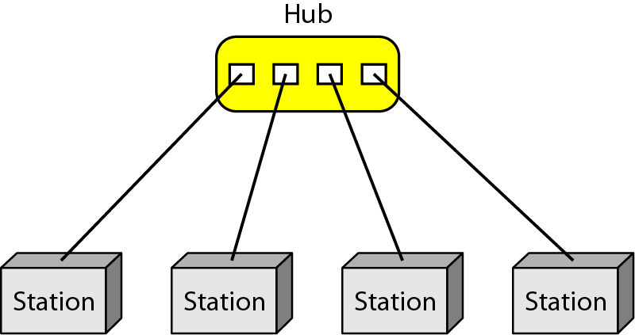
Star Topology
In a star topology, each device has a dedicated point-to-point link only to a central controller, called hub.
Controller relays the data to the other connected device.
Advantages:
  Robustness
  Easy fault identification
Disadvantages: Single point failure.
An application: Local-area networks (LANs).

Slide 22
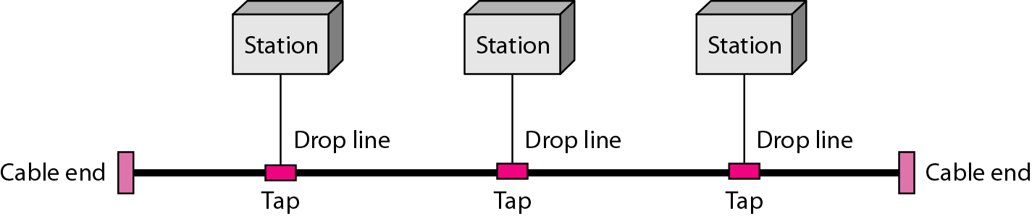
Bus Topology
A bus topology is a multipoint topology. One long cable acts as a backbone.
Advantages:
  Less cabling than mesh or star topologies.
Disadvantages:
  Difficult reconnection.
  Signal reflection at the taps can cause degradation in quality.
  Single point failure.
An application: Earlier Local-area networks (LANs).

Slide 23

Ring Topology
In a ring topology, each device has a dedicated point-to-point connection with only the two devices on either side of it.
Each device incorporates a repeater.
Advantages:
  Easy to add device.
Disadvantages:
  Unidirectional traffic.
An application: Earlier LAN of IBM.

Slide 24
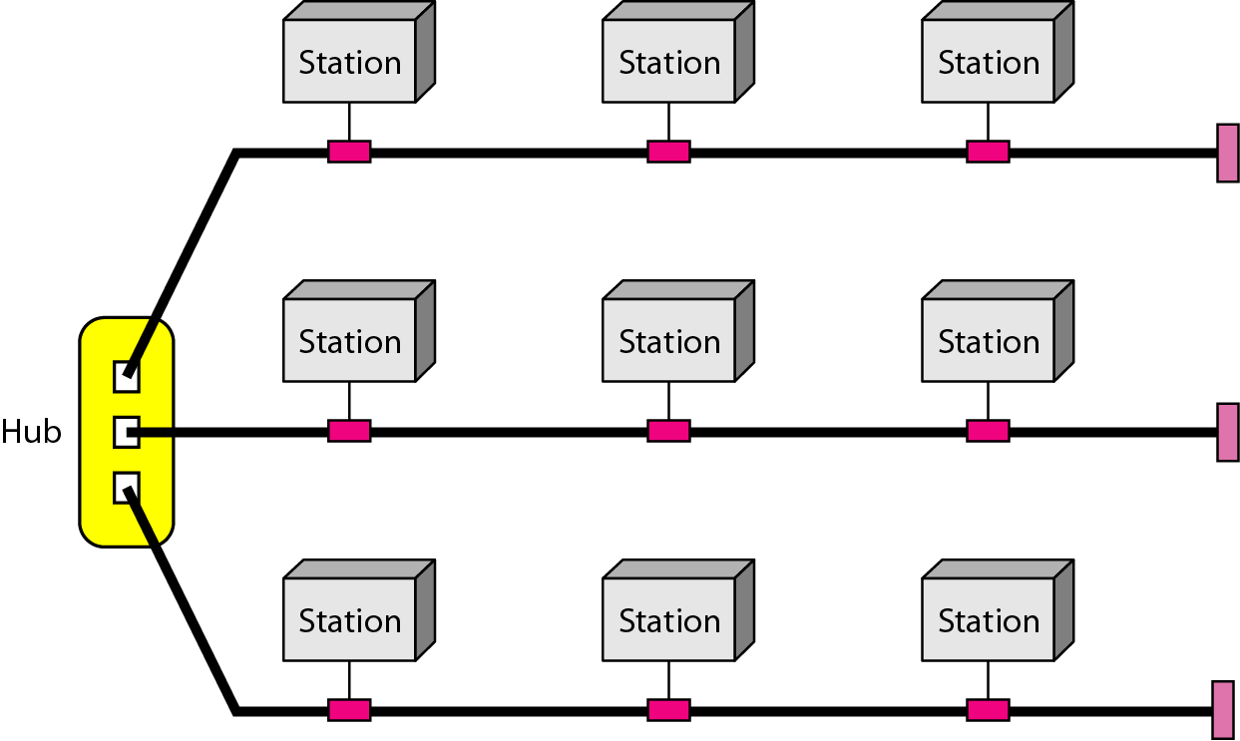
A hybrid topology: a star backbone with three bus networks

Slide 25
Network Categories
Network category is determined by its size and its physical architecture
Network
Local area network (LAN)
Wide area network (WAN)
Metropolitan area network (MAN)

Slide 26
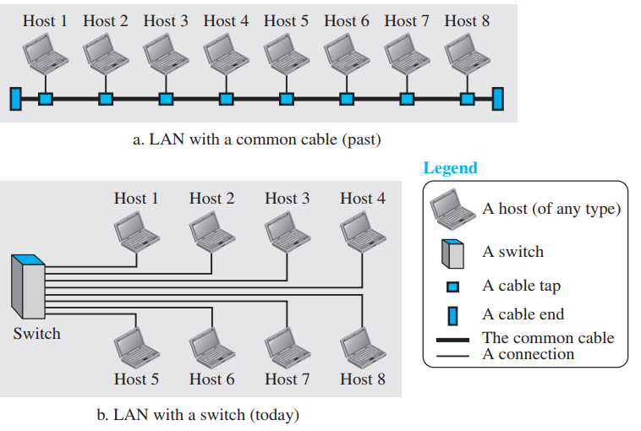
Local area network (LAN)
A local area network (LAN) is usually privately owned and connects some hosts in a single office, building, or campus (like CGU).
Each host in a LAN has an address.
Definition of a LAN does not define the minimum or maximum number of hosts in a LAN.
LAN use any physical topology (Bus, ring and star).
LAN covers an area < 2 miles.

Slide 27

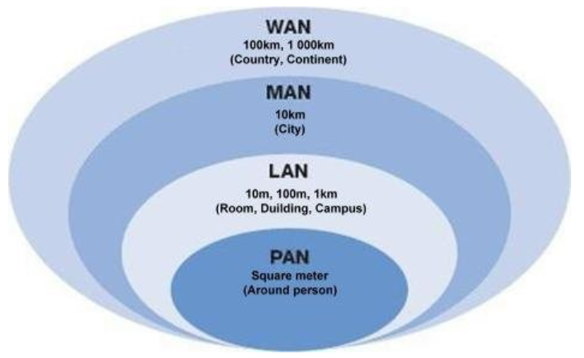
Wide area network (WAN)
Provide long distance transmission of data, image, audio and video information over large areas.
Covers a large geographical area, like a country or continent. Connects LANs and MANs.

Slide 28
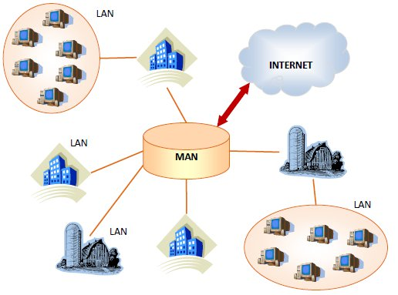
Metropolitan area network (MAN)
Its size is in between LAN and WAN.
Covers the area inside a town or a city.
Example: Cable TV network used for high-speed data connection to the internet.

Slide 29
Parameter | LAN (Local Area Network) | MAN (Metropolitan Area Network) | WAN (Wide Area Network)
Coverage Area | Covers a small geographical area such as a room, building, office, or campus. | Covers a city or metropolitan area. | Covers a country, continent, or the entire world.
Ownership | Privately owned and managed by a single organization or institution. | Owned and managed by a government, ISP, or large organization. | Managed by telecom operators, ISPs, or multiple organizations.
Transmission Speed | Very high (typically 100 Mbps to several Gbps). | High, but generally lower than LAN. | Lower than LAN and MAN due to long-distance communication.
Installation Cost | Low | Moderate | High
Transmission Medium | Ethernet cables, Fiber Optic cables, and Wi-Fi. | Fiber Optic cables, and Microwave links. | Fiber Optic, Leased Lines, Satellite links
Propagation Delay | Very low because of the short communication distance. | Moderate due to wider geographical coverage. | High because data travels over long distances.
Examples | Home network, office network, computer laboratory, college campus network. | City-wide university network, cable TV network, smart city network | Internet, banking network,, multinational corporate network.

Slide 30
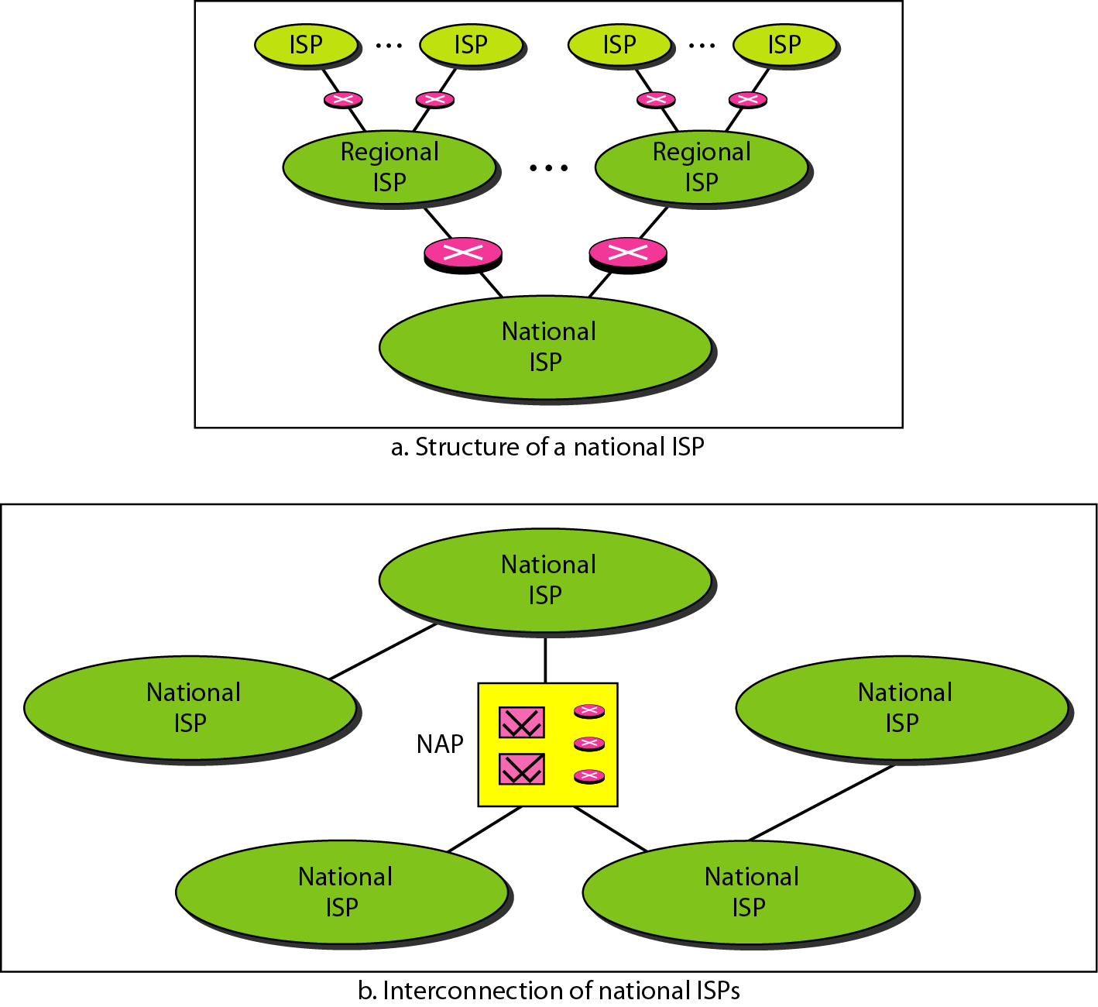
Internet Today
  Made of many LANs and WANs
  Every day new networks area added and removed
  Internet services Providers (ISPs) offer services to the end users
    International service providers
    National service providers
    Regional service providers
    Local service providers

Slide 31
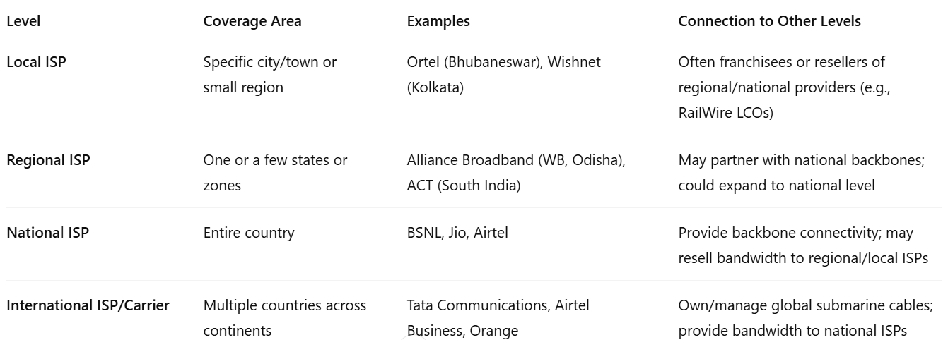
Internet Today: Examples

Slide 32
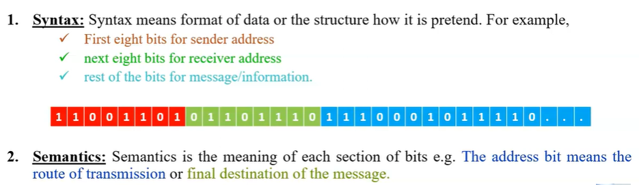
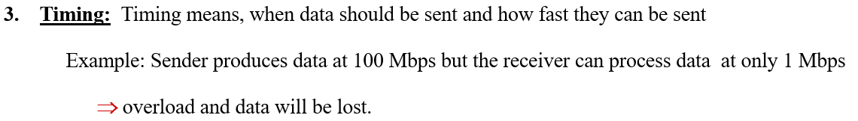
Protocols
  A protocol is a set of rules that govern data communications. Defines the methods of Communication, what to communicate, when to communicate, how to communicate etc.

Slide 33
Standards
Standard provides guidelines to manufacturers, vendors, government agencies, and other service providers. It ensure about the interconnectivity and compatible of the devices.
It helps in creating and maintaining an open and competitive market for equipment manufactures.
Data communication standards fall into two categories:
1. De facto
De facto means by facts or by conventions.
The standards that are not approved by an organized but are widely used are De facto standards. These are established by manufacturer.
2. De jure:
De jure means by law or by regulations.
These are the standards that are recognized officially by organizations.

Slide 34
Standards
International Standards Organization (ISO): Developing cooperation in the realms of scientific, technological and economic activity.
International Telecommunication Union (ITU) : Research and establishment of standards for telecommunication in general
Institute of Electrical and Electronics Engineers (IEEE): It aims to advance theory, creativity and product quality in the fields of electrical engineering, electronics and radio as well as in all related branches of engineering.
Electronic Industries Association (EIA): Promotion of electronics manufacturing concerns.

Slide 35
Network Models

Slide 36
Network
A network is a combination of hardware and software that sends data from one location to another.
The hardware consists of the physical equipment that carries signals from one point of the network to another.
The software consists of instruction sets that make possible the services that we expect from a network.

Slide 37
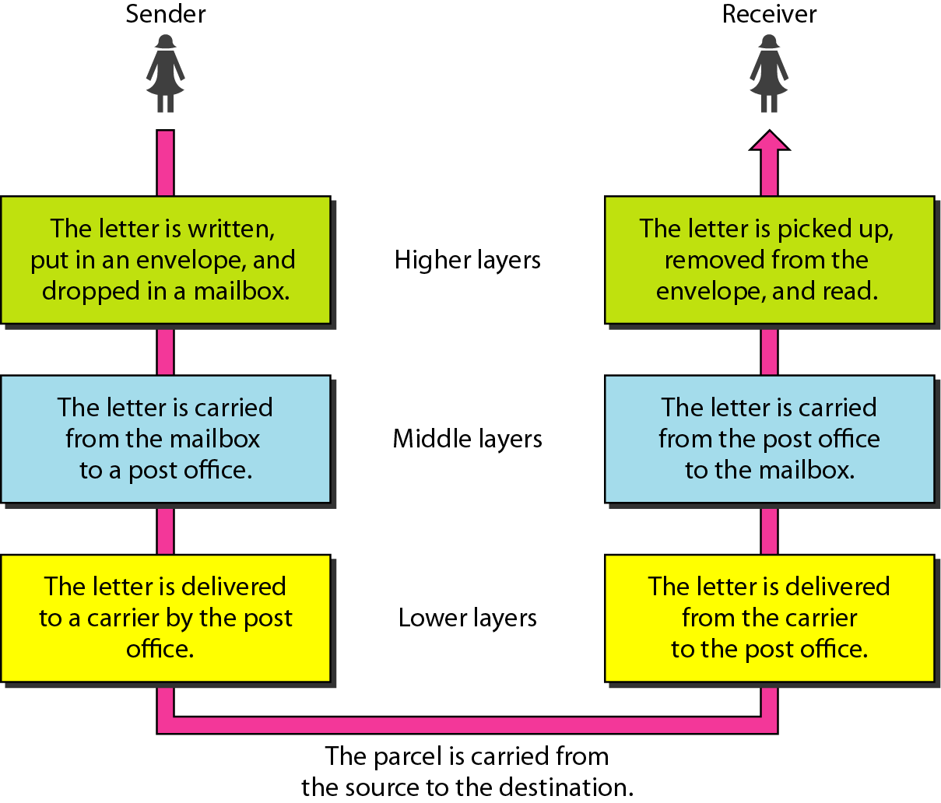
LAYERED TASKS
We use the concept of layers in our daily life. As an example, let us consider two friends who communicate through postal mail. The process of sending a letter to a friend would be complex if there were no services available from the post office.

Slide 38
Tasks involved in sending a letter
At the Sender Site
Higher Layer: The sender writes the letter, inserts the letter in an envelope, writes the sender and receiver addresses and drops the letter in a mailbox.
Middle Layer: The letter is picked up by a letter carrier and delivered to the post office.
Lower Layer: The letter is sorted at the post office; a carrier transports the letter.
    Lower Layer: The carrier transports the letter to the post office.
    Middle Layer: The letter sorted and delivered to the recipient's mailbox.
    Higher Layer: The receiver picks up the letter, opens the envelope, and reads it.
At the Receiver Site

Slide 39

THE OSI MODEL
Established in 1947, the International Standards Organization (ISO) is a multinational body dedicated to worldwide agreement on international standards.
An ISO standard that covers all aspects of network communications is the Open Systems Interconnection (OSI) model. It was first introduced in the late 1970s.

Slide 40
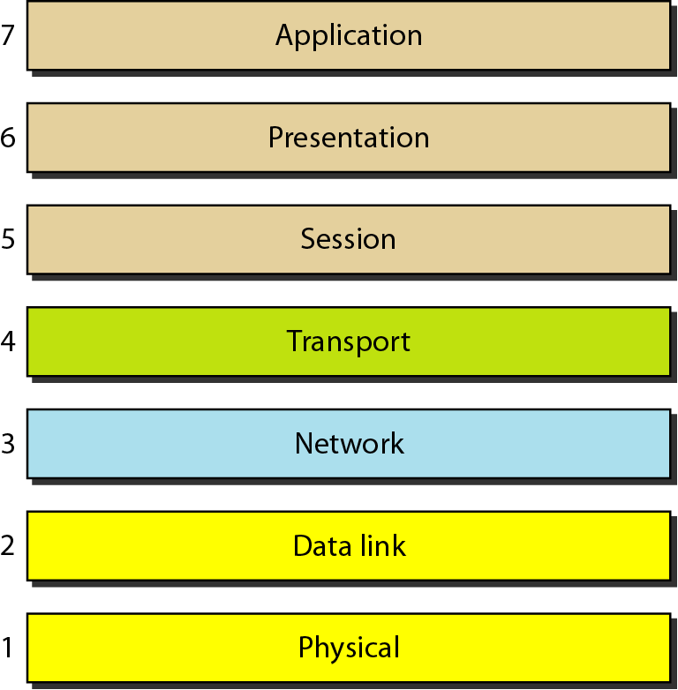
Seven layers of the OSI model

Slide 41
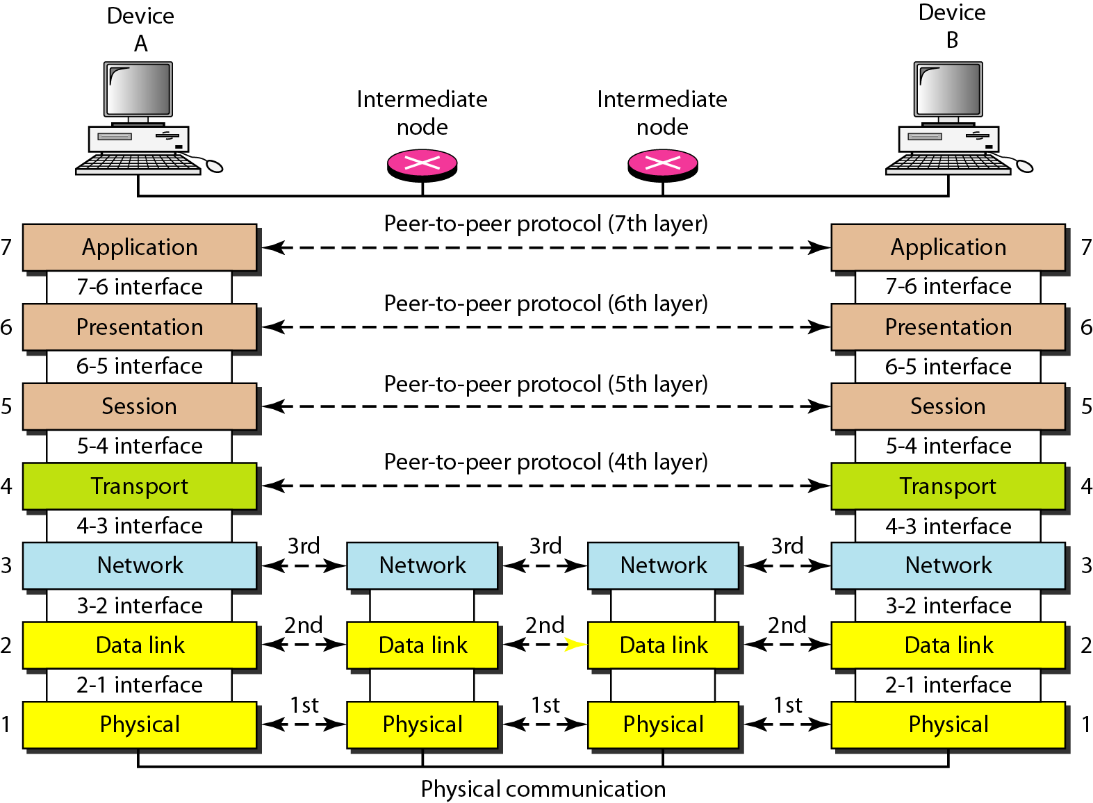
Interaction between Layers in the OSI model

Slide 42
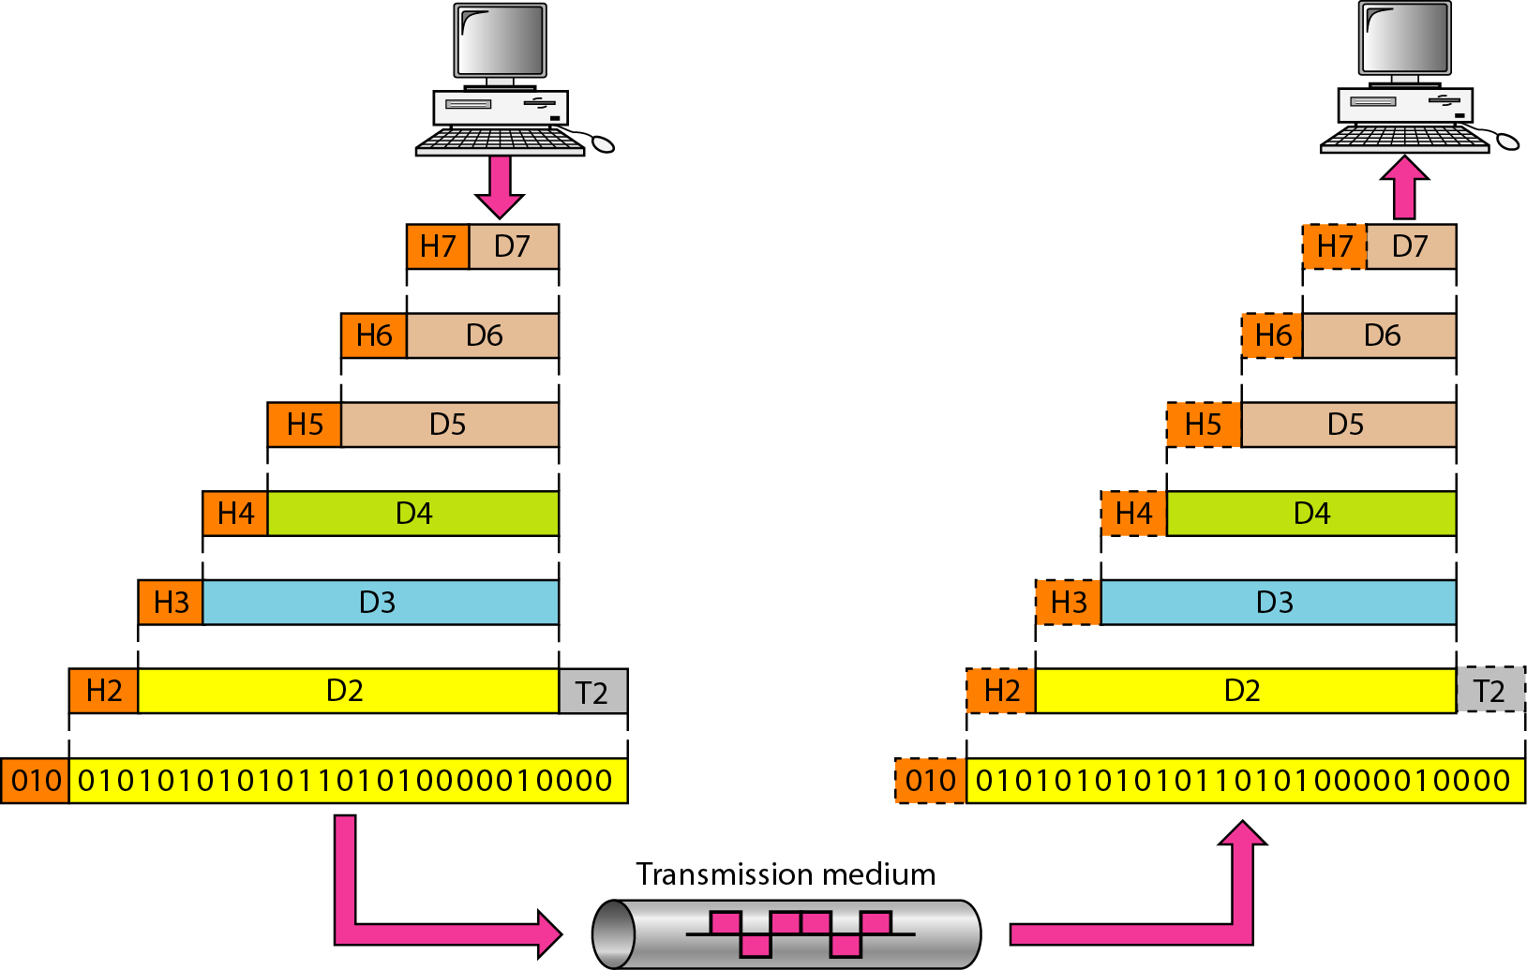


An exchange using the OSI model
In a networking model, the term encapsulation refers to a process in which protocol information is added to the data.
The term de-encapsulation refers to a process in which information added through the encapsulation process is removed.

Slide 43
LAYERS IN THE OSI MODEL
In this section we briefly describe the functions of each layer in the OSI model.
Topics discussed in this section:
Physical Layer
Data Link Layer
Network Layer
Transport Layer
Session Layer
Presentation Layer
Application Layer

Slide 44
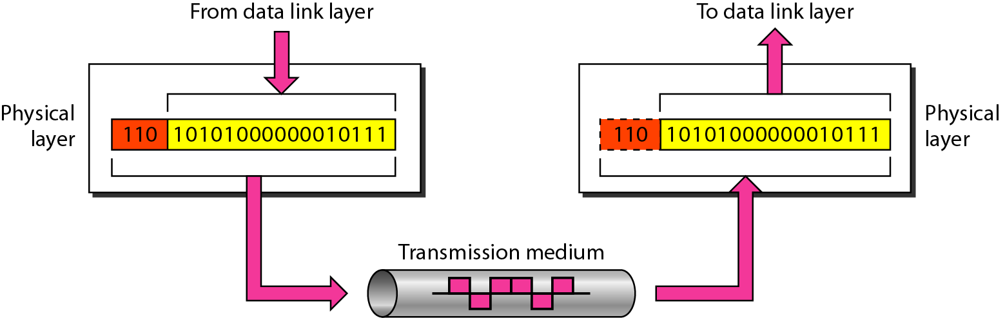
Physical layer
It deals with the physical transmission of data over a communication medium.
It deals with the mechanical and electrical specifications of the interface and transmission medium.
Services Provided
Physical characteristics of the media
Representation of bits
Data rate
Line configuration
Physical topology
Transmission mode

Slide 45
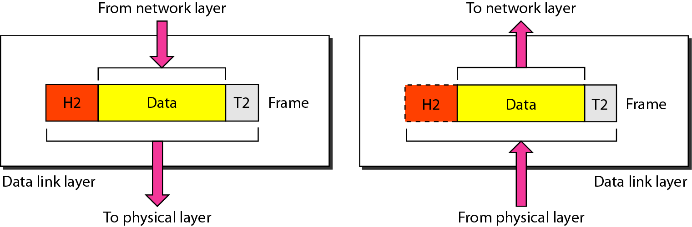
Data link layer
The data link layer is responsible for moving frames from one node to the next node.
It makes the physical layer appear error-free to the upper layer (Network layer)
Services Provided
Framing
Physical addressing (MAC address)
Flow control
Error control
Access control

Slide 46
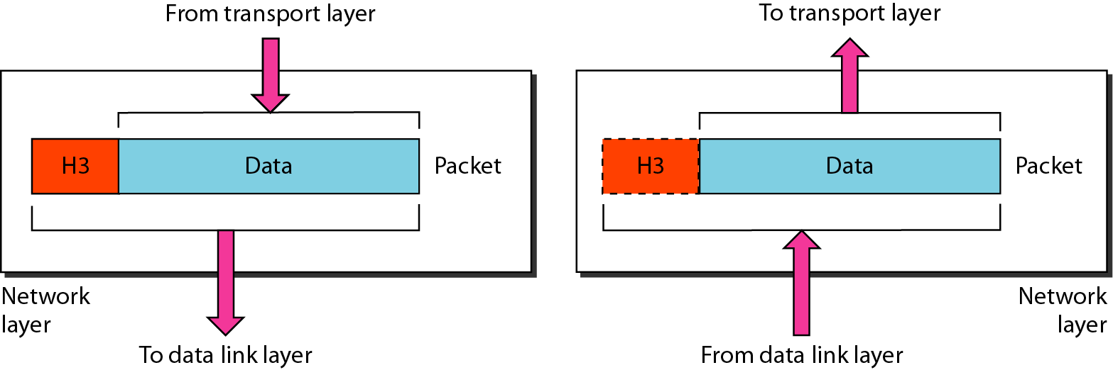
Network layer
The network layer is responsible for the source-to-destination delivery of a packet.
The data link layer oversees the delivery of the packet between two systems on the same network.
The network layer ensures that each packet gets from its point of origin to its final destination.
Services provided:
Logical addressing (IP address)
Routing

Slide 47
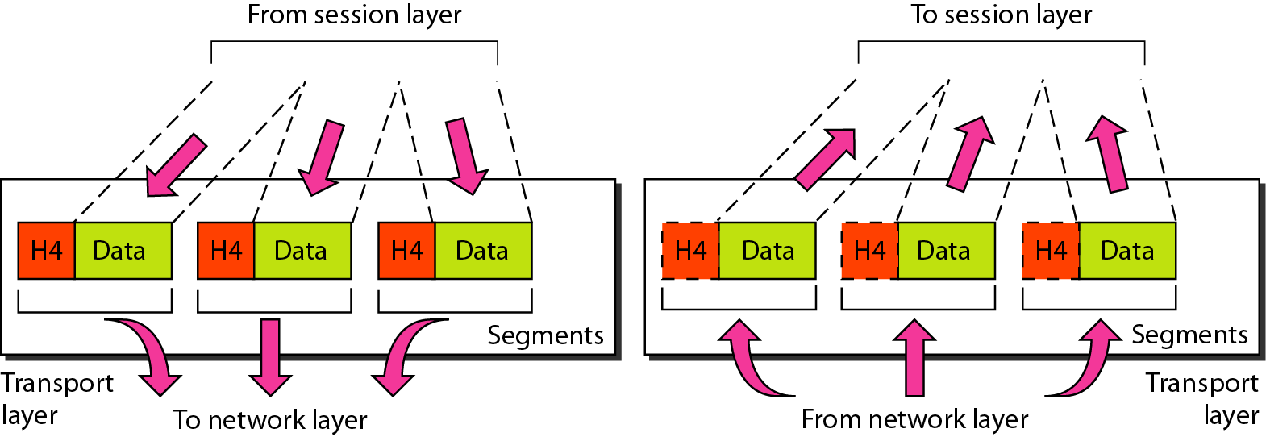
Transport layer
The transport layer is responsible for process-to-process delivery of the entire message.
We need a port number, to choose among multiple processes running on the destination host
The network layer oversees source-to-destination delivery of individual packets.
Services provided:
Service-point (Port) addressing
Segmentation and Reassembly
Connection control
Flow control
Error control

Slide 48
NOTE
Data Link Layer requires the MAC address (48 bits address contained inside the Network Interface Card (NIC) of every host machine) of source-destination hosts to correctly deliver a frame and the Network layer requires the IP address for appropriate routing of packets, in a similar way Transport Layer requires a Port number to correctly deliver the segments of data to the correct process amongst the multiple processes running on a particular host. A port number is a 16-bit address used to identify any client-server program uniquely.

Slide 49
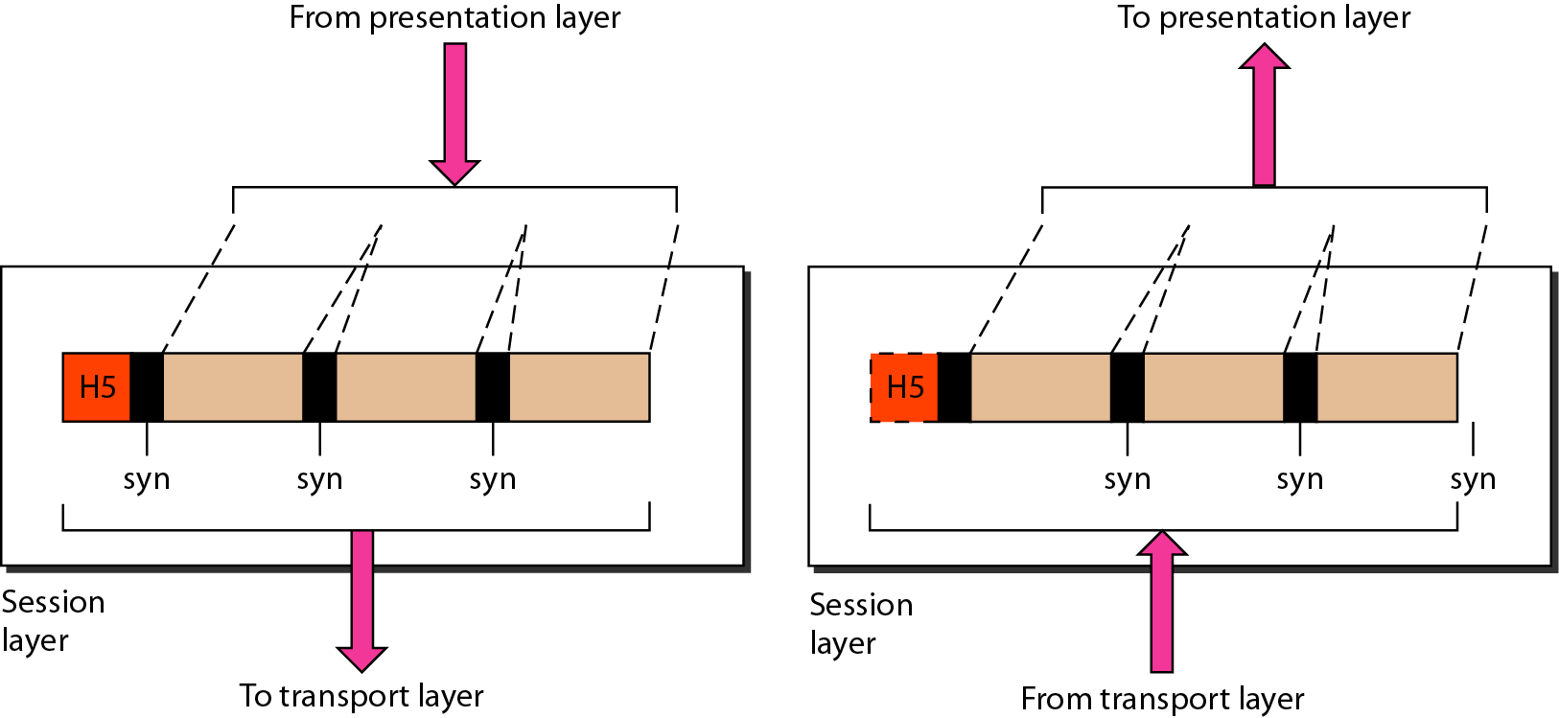
Session layer
The session layer is responsible for establishing, managing, and terminating sessions between two communicating devices
Services provided:
Dialog control
Synchronization

Slide 50
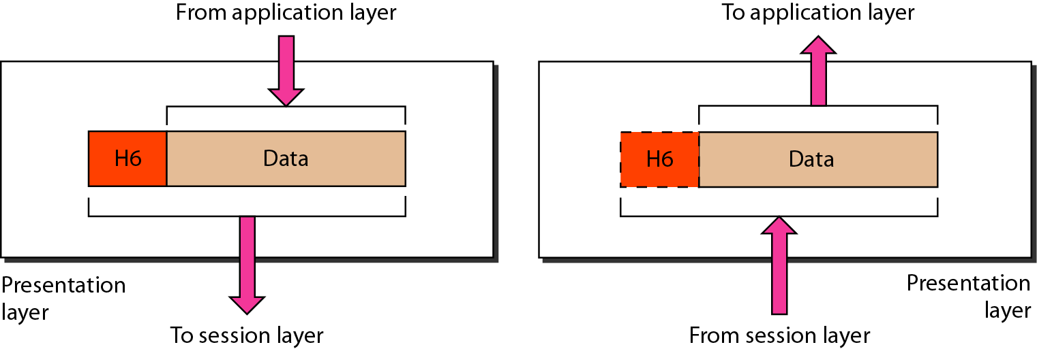
Presentation layer
The presentation layer is responsible for translation, compression and encryption.
Services provided:
Translation
Encryption
Compression

Slide 51
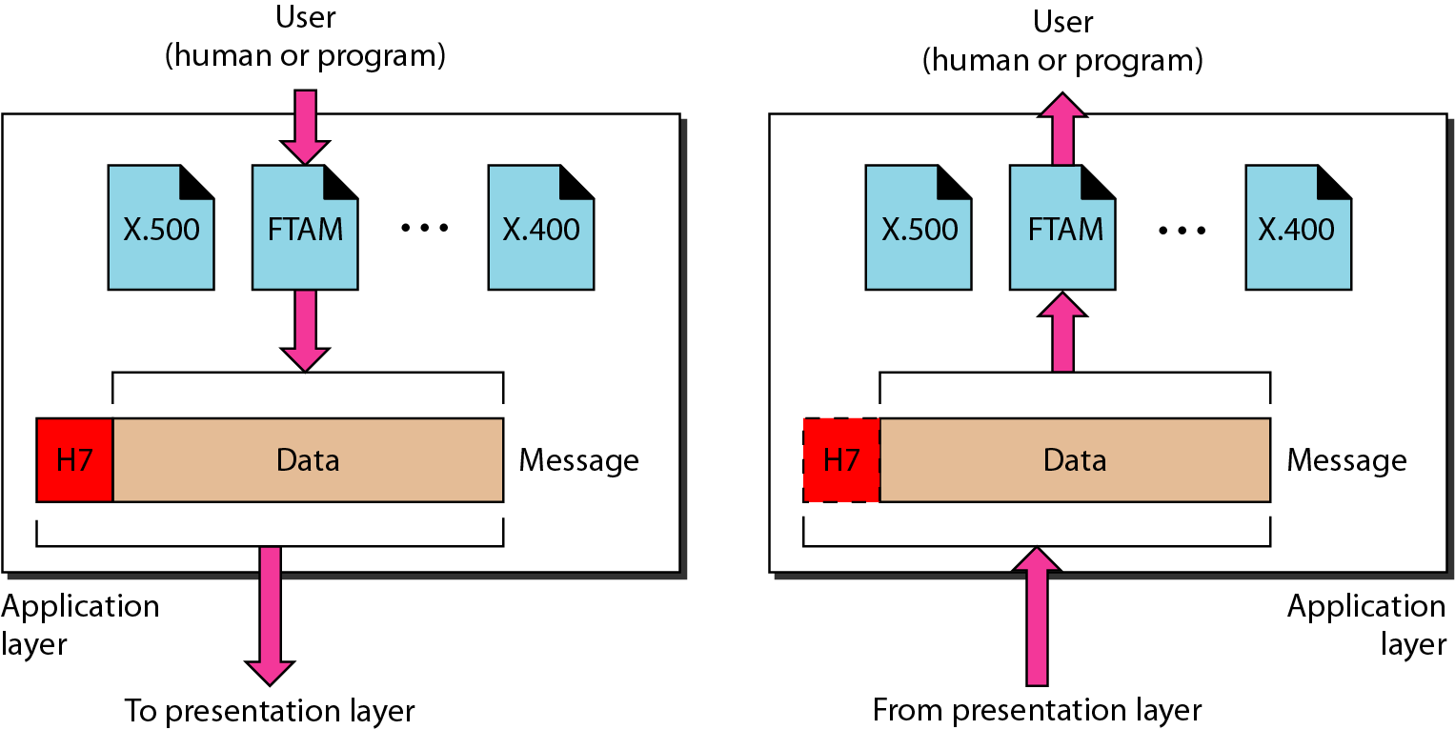
Application layer
The application layer is responsible for providing services to the user.
It provides user interfaces and support for services such as electronic mail, remote file access and transfer and other types of distributed information services.
Services provided:
Files transfer and Access management (FTAM)
Mail Services
Directory services

Slide 52
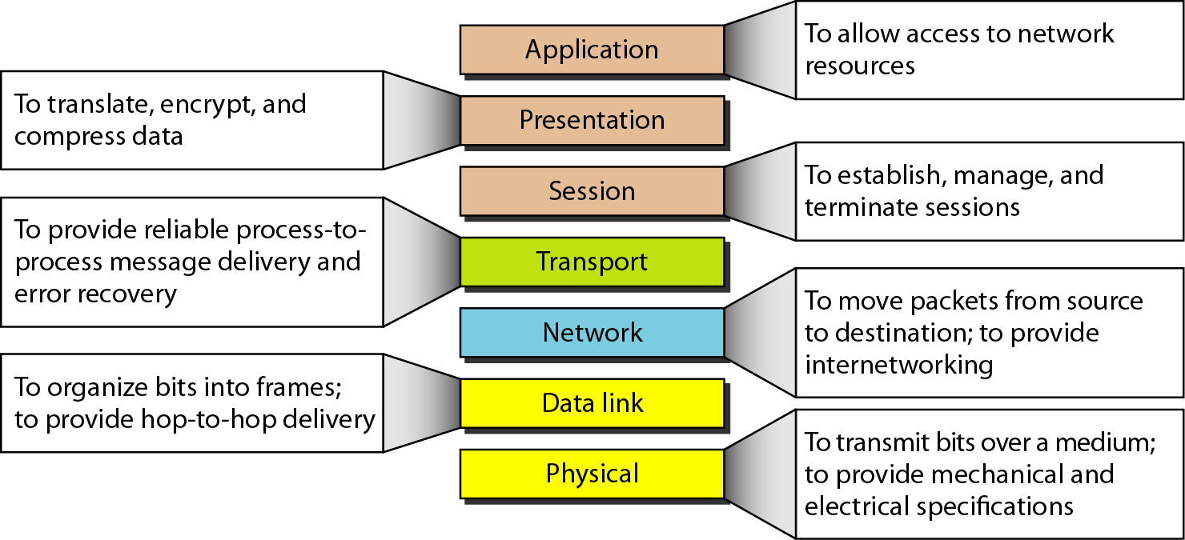
Summary of layers

Slide 53
TCP/IP Protocol Suite
TCP/IP stands for Transmission Control Protocol/ Internet Protocol
The TCP/IP model is widely used and forms the basis of the internet. The OSI model, while not as directly applied in network architecture, serves as a comprehensive guide for understanding and designing network systems.

Slide 54
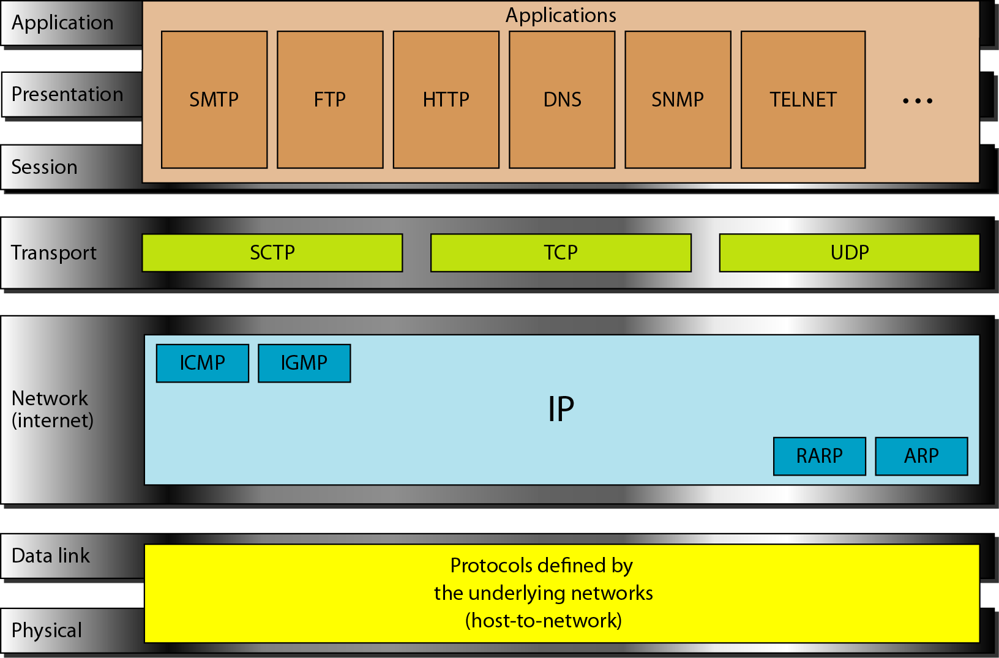
TCP/IP Model

Slide 55
Host-to-network Layer
This is the lowest layer of the TCP/IP model.
The host-to-network layer is the combination of the physical layer and data link layer defined in the OSI reference model.
This layer is mainly responsible for the transmission of the data between two devices on the same network.

Slide 56
Network Layer
The communication at the network layer is host-to-host.
Network layer supports four protocol: IP, ARP, RARP, ICMP, IGMP.
Internetworking protocol (IP):
IP transports data in packets called datagrams, each of which is transported separately.
Datagrams can travel along different routes and can arrive out of sequence order.
IP does not keep track of the routes and has no facility for reordering datagrams once they arrive at their destination.

Slide 57
ARP:
ARP stands for Address Resolution Protocol.
ARP is used to find out the physical address of the node when its IP address is known.
RARP:
RARP stands for Reverse Address Resolution Protocol.
It allows a host to discover its IP address when it knows only its physical address.
It is used when a computer is connected to a network for the first time.

Slide 58
ICMP:
It stands for Internet Control Message Protocol.
It is a mechanism used by the hosts or gateways to send notifications regarding datagram problems back to the sender.
IGMP:
It stands for Internet Group Message Protocol.
It is used to facilitate the simultaneous transmission of a message to a group of recipients.

Slide 59
Transport Layer
The transport layer is responsible for the reliability, flow control, and correction of data which is being sent over the network.
The two protocols used in the transport layer are User Datagram protocol (UDP) and Transmission control protocol (TCP).
TCP (Transmission Control Protocol) is connection-oriented and ensures reliable, ordered, and error-checked delivery of data.
UDP (User Datagram Protocol) is connectionless and prioritizes speed and efficiency over guaranteed delivery.

Slide 60
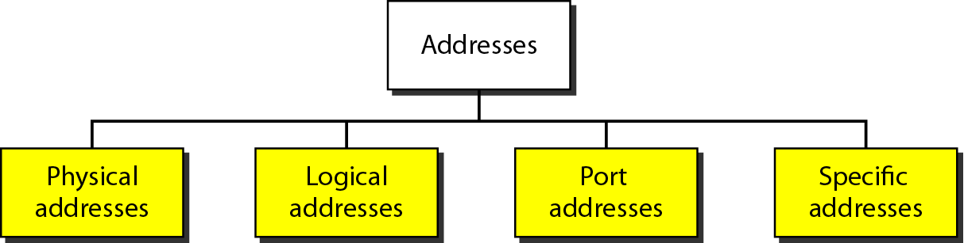
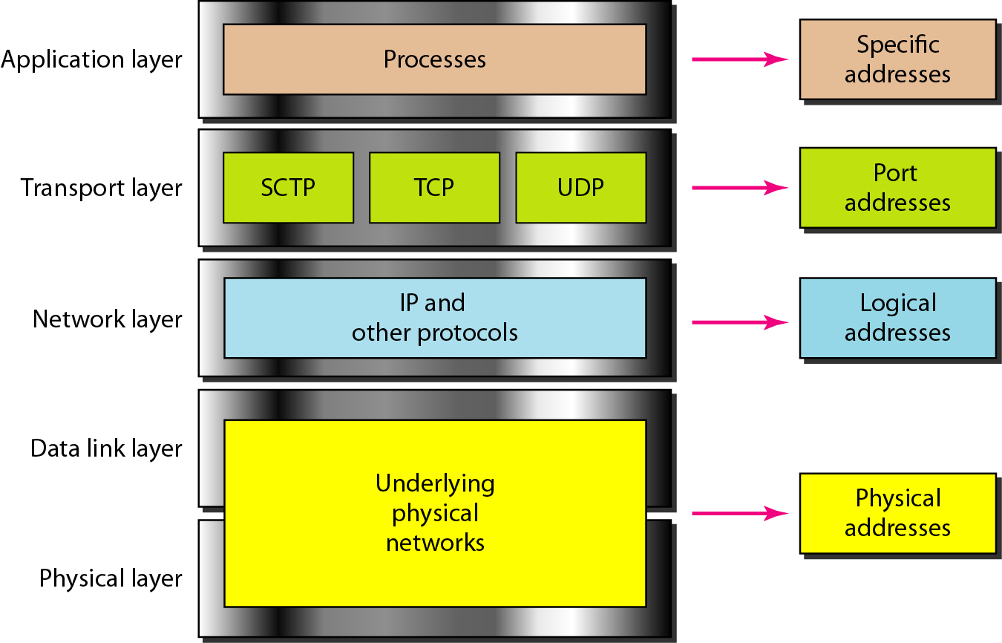
Addresses in TCP/IP

Slide 61
Data & Signal

Slide 62
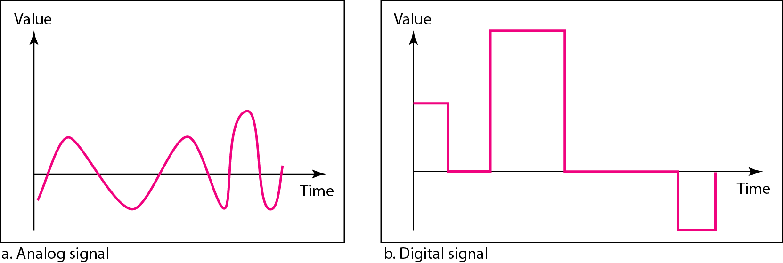
Data and Signals
Analog and Digital Data: The term analog data refers to information that is continuous; digital data refers to information that has discrete states.
Analog and Digital Signals: An analog signal has infinitely many levels of intensity over a period of time. A digital signal, on the other hand, can have only a limited number of defined values.

Slide 63
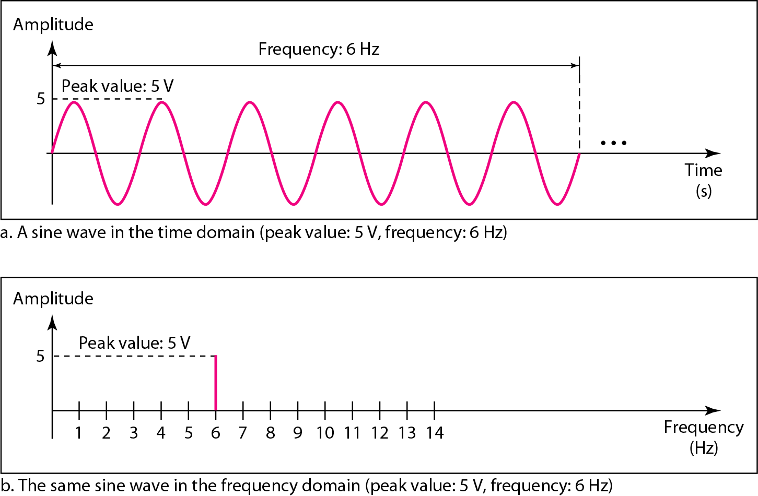

PERIODIC ANALOG SIGNALS
In data communications, we commonly use periodic analog signals and nonperiodic digital signals.
Periodic analog signals can be classified as simple or composite. A simple periodic analog signal, a sine wave, cannot be decomposed into simpler signals.
Frequency and period are the inverse of each other.

Slide 64
The power we use at home has a frequency of 60 Hz. The period of this sine wave can be determined as follows:

Slide 65
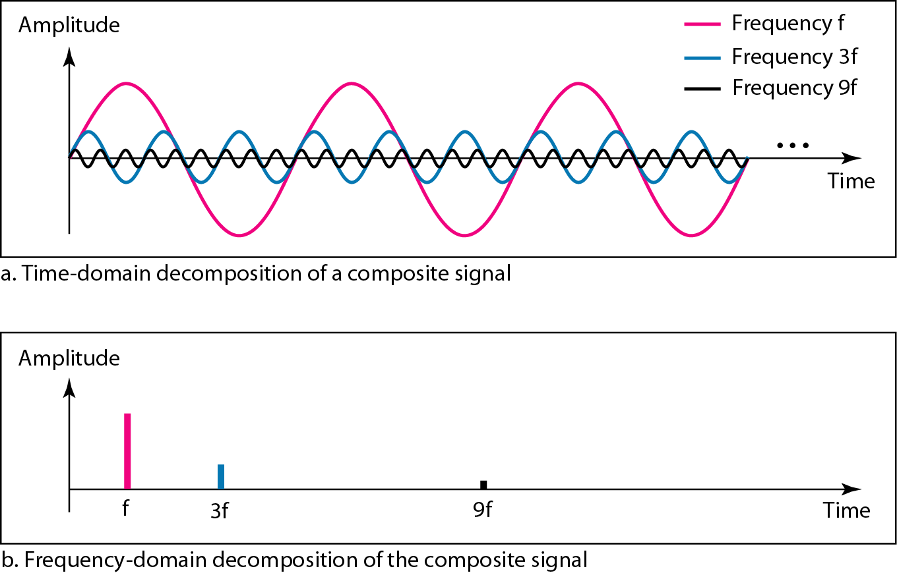
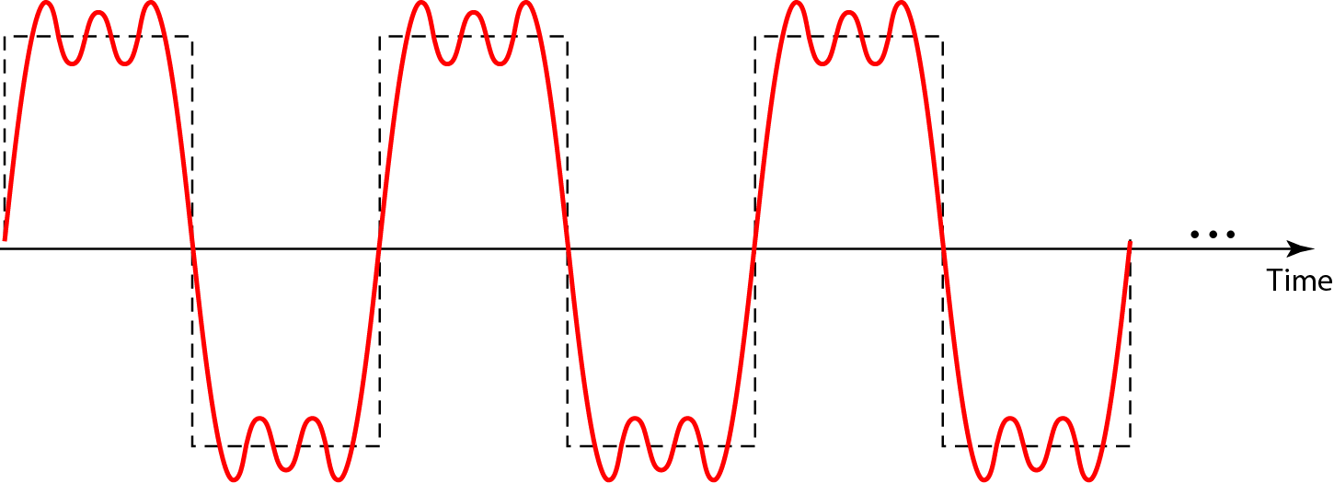
Composite Signal
A composite signal is made of many simple sine waves.
Decomposition of a composite periodic signal in the time and frequency domains
According to Fourier analysis, any composite signal is a combination of simple sine waves with different frequencies, amplitudes, and phases.

Slide 66
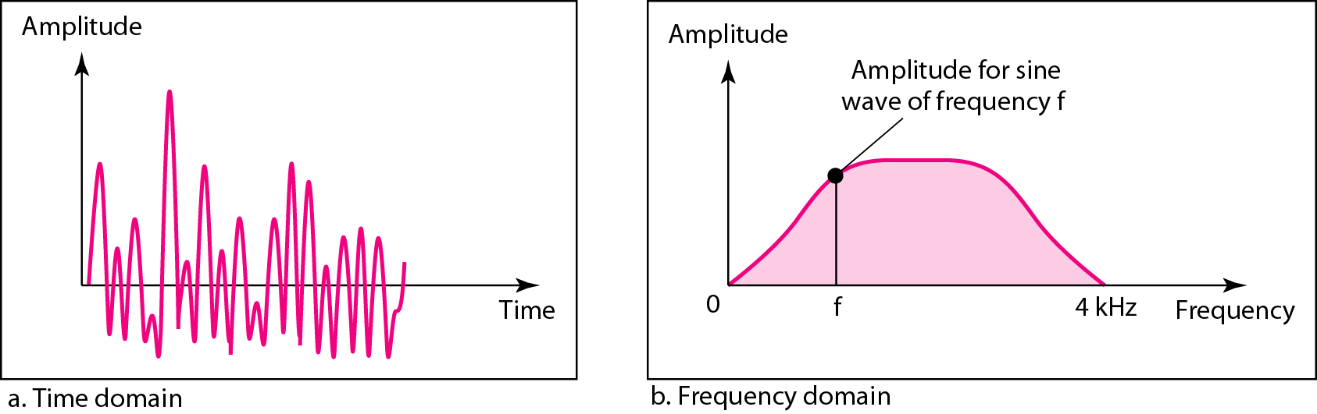
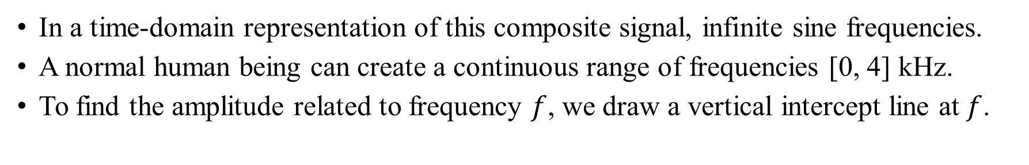
Aperiodic Analog Composite Signals
In a time-domain representation of this composite signal, infinite sine frequencies.
A normal human being can create a continuous range of frequencies [0, 4] kHz.
To find the amplitude related to frequency $f$, we draw a vertical intercept line at $f$.

Slide 67
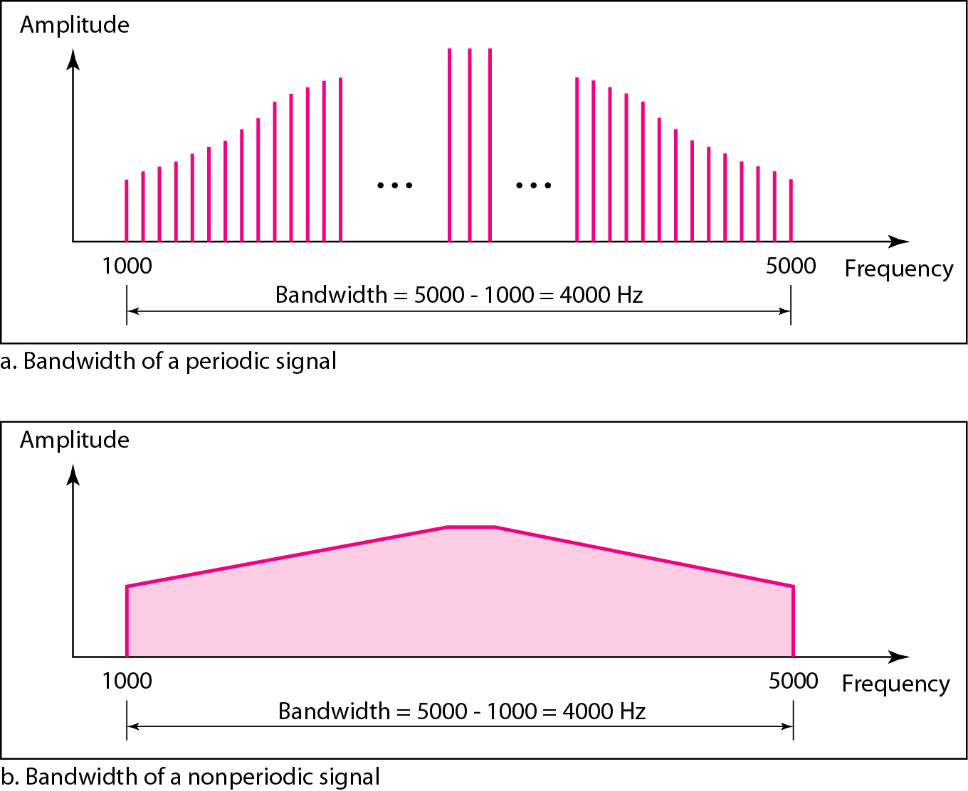
Bandwidth and Signal Frequency
The bandwidth of a composite signal is the difference between the highest and the lowest frequencies contained in that signal.
The bandwidth of the periodic signal contains all integer frequencies between 1000 and 5000 (1000, 1001, 1002, . . .).
The bandwidth of the nonperiodic signals has the same range, but the frequencies are continuous.

Slide 68
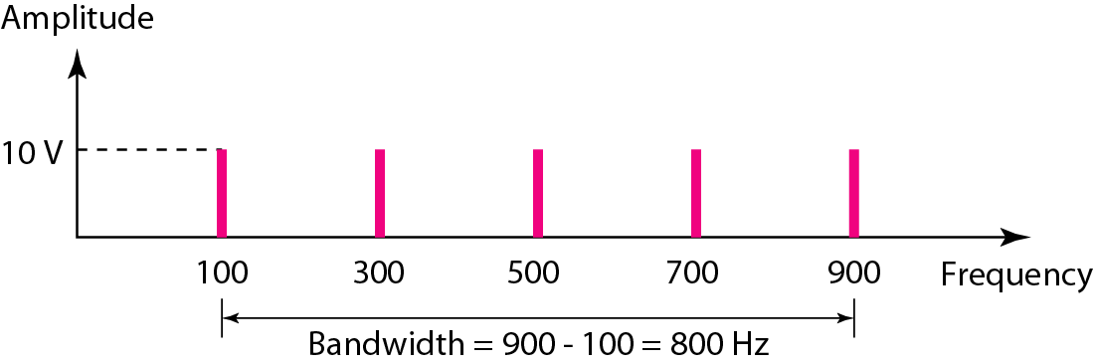
If a periodic signal is decomposed into five sine waves with frequencies of 100, 300, 500, 700, and 900 Hz, what is its bandwidth? Draw the spectrum, assuming all components have a maximum amplitude of 10 V.
Solution
Let f_{h} be the highest frequency, f_{l} the lowest frequency, and B the bandwidth. Then
The spectrum has only five spikes, at 100, 300, 500, 700, and 900 Hz

Slide 69
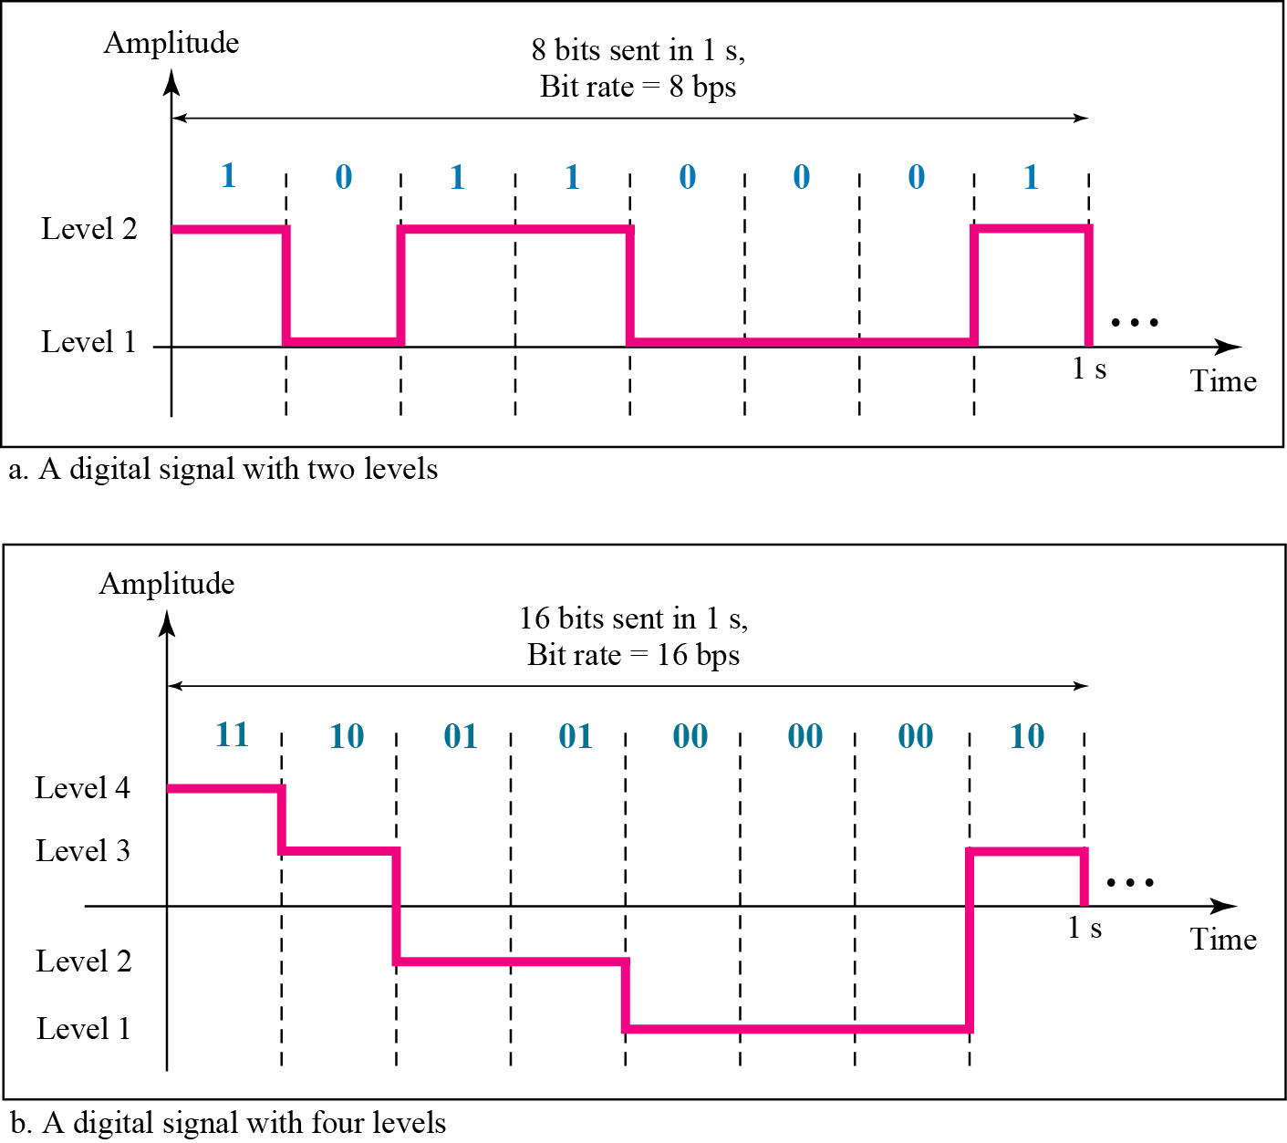
Digital Signal
A digital signal is a signal that represents data as a sequence of discrete values; at any given time.
For example, a 1 can be encoded as a positive voltage and a 0 as zero voltage.
A digital signal can have more than two levels. In this case, we can send more than 1 bit for each level.
Two digital signals: one with two signal levels and the other with four signal levels

Slide 70

Data Rate Limits
Data rate limit means how fast we can send data in bits per second, over a channel.
Data rate depends on three factors:
- bandwidth available
- level of the signals we use
- quality of the channel (the level of noise)
Noiseless Channel: Nyquist Bit Rate
$$Bit Rate=2 ×Channel Bandwidth × \log_{2}L$$
Where $L$ is the number of signal levels used to represent data.

Slide 71
Data Rate Limits
Noisy Channel: Shannon Capacity
$$Capacity =Channel Bandwidth × \log_{2}\left(1+SNR\right)$$
- It is measured in bps.
Example: Calculate the theoretical highest bit rate of a regular telephone line. A telephone line normally has a bandwidth of 3000 Hz (300 to 3300 Hz) assigned for data communications. The signal-to-noise ratio is usually 3162.

Slide 72
We need to send 265 kbps over a noiseless channel with a bandwidth of 20 kHz. How many signal levels do we need?
Solution
We can use the Nyquist formula as shown:
Since this result is not a power of 2, we need to either increase the number of levels or reduce the bit rate. If we have 128 levels, the bit rate is 280 kbps. If we have 64 levels, the bit rate is 240 kbps.

Slide 73
We can calculate the theoretical highest bit rate of a regular telephone line. A telephone line normally has a bandwidth of 3000. The signal-to-noise ratio is usually 3162. For this channel the capacity is calculated as
This means that the highest bit rate for a telephone line is 34.860 kbps. If we want to send data faster than this, we can either increase the bandwidth of the line or improve the signal-to-noise ratio.

Slide 74
The signal-to-noise ratio is often given in decibels. Assume that SNR_{dB} = 36 and the channel bandwidth is 2 MHz. The theoretical channel capacity can be calculated as

Slide 75
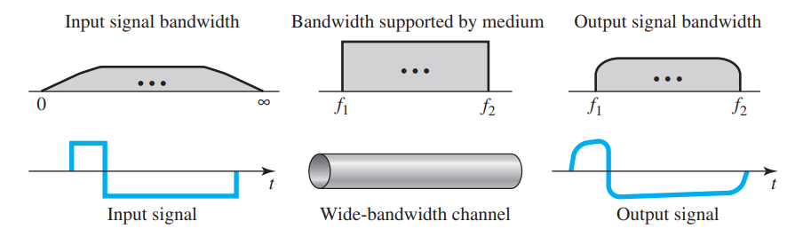
Transmission of Digital Signals
Low-Pass Channel with Wide Bandwidth
Baseband transmission using a dedicated medium

Slide 76
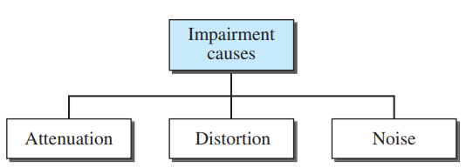
Transmission Impairments
Signals travel through transmission media, which are not perfect. The imperfection causes signal impairment.
This means that the signal at the beginning of the medium is not the same as the signal at the end of the medium.
Three causes of impairment are attenuation, distortion, and noise.

Slide 77
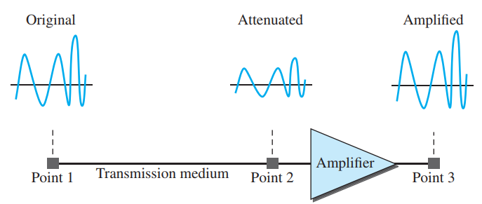
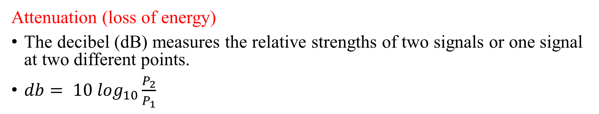
Transmission Impairments
Attenuation (loss of energy)
The decibel (dB) measures the relative strengths of two signals or one signal at two different points.
$db= {10 log}_{10}\frac{P_{2}}{P_{1}}$

Slide 78
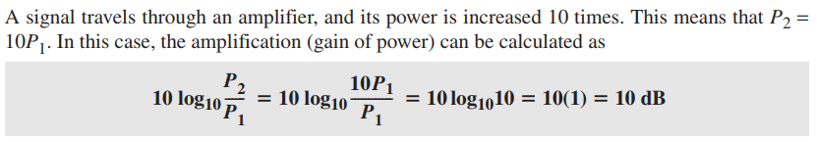
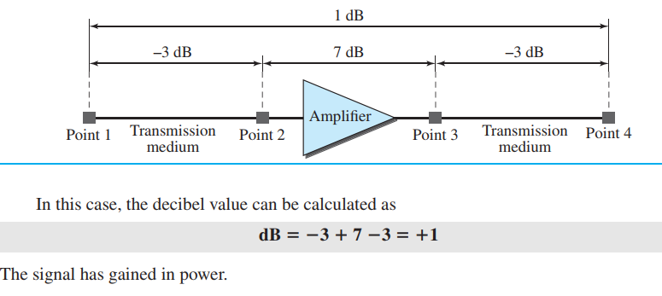
Numerical on Attenuation

Slide 79
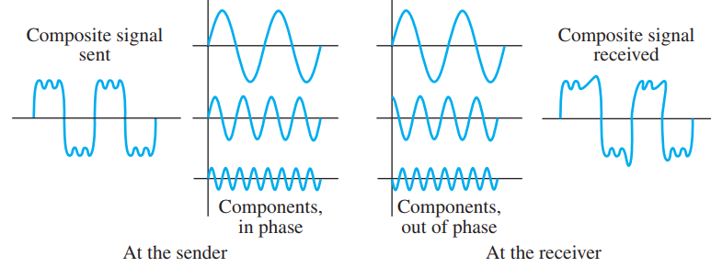
Transmission Impairments
Distortion (Signal changes its form or shape)
Distortion occurs in composite signals. Each frequency component has its own propagation speed traveling through a medium.
The different components therefore arrive with different delays at the receiver. That means that the signals have different phases at the receiver than they did at the source.

Slide 80
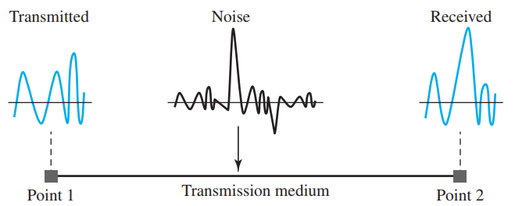
Transmission Impairments
Noise (Absolutely unwanted signals)
Thermal noise (Electrons)
Induced noise (Ignition)
Impulse noise (lightning)

Slide 81
The power of a signal is 10 mW and the power of the noise is 1 μW; what are the values of SNR and SNR_{dB} ?
Solution
The values of SNR and SNRdB can be calculated as follows:

Slide 82
LINE CODING

Slide 83

Line Coding
A computer network is designed to send information from one point to another. This information needs to be converted to either a digital signal or an analog signal for transmission.
Line coding is the process of converting digital data to digital signals.
Line coding converts a sequence of bits to a digital signal.
At the sender, digital data are encoded into a digital signal; at the receiver, the digital data are recreated by decoding the digital signal.

Slide 84

Signal Element Vs. Data Element
A data element is the smallest entity that can represent a piece of information (bit).
A signal element is the shortest unit (time wise) of a digital signal.
In digital data communications, a signal element carries data elements.
Data elements are what we need to send; signal elements are what we can send.
Data elements are being carried; signal elements are the carriers.

Slide 85
Data Rate Vs. Signal Rate
The data rate defines the number of data elements (bits) sent in 1s. The unit is bits per second (bps).
The signal rate is the number of signal elements sent in 1s. The unit is the baud.
The data rate is sometimes called the bit rate; the signal rate is sometimes called the pulse rate, the modulation rate, or the baud rate.
The relationship between data rate and signal rate is given by
S=C × N × 1/r baud
N= Data rate (bps);
C = the case factor, which varies for each case;
S = Signal rate
r = ratio of no. data element to no. signal element
Bandwidth is proportional to the signal rate. The minimum bandwidth is given by
B_{min}= C × N × 1/r

Slide 86
Example
A signal is carrying data in which one data element is encoded as one signal element (r=1). If the bit rate is 100 Kbps, what is the average value of the baud rate if c is between 0 and 1?
Solution:
We assume that the average value of C is 1/2. The baud rate is then
S= c × N×1/r =1/2 × 100000 ×1/1 =50,000= 50 kbaud

Slide 87

Figure: Line coding schemes

Slide 88

Unipolar
All signal levels are on one side of the time axis - either above or below
NRZ - Non Return to Zero scheme is an example of this code. The signal level does not return to zero at the middle of the bit.
In this scheme, positive voltage defines bit 1 and zero voltage defines bit 0.

Slide 89

Polar NRZ
In polar schemes, the voltages are on both sides of the time axis.
Polar NRZ scheme can be implemented with two voltages. E.g. +V for 1 and -V for 0.
There are two versions: NRZ - Level (NRZ-L) , NRZ - Inversion (NRZ-I)
If there is a long sequence of 0s or 1s in NRZ-L, the average signal power becomes skewed.
There are DC components that carry a high level of energy.
f/N — Normalized Frequency
f — Frequency
N — Data Rate (bps)

Slide 90
Example
A system is using NRZ-I to transfer 1-Mbps data. What are the average signal rate and minimum bandwidth?
Solution
The average signal rate is S= c ×N ×1/R = 1/2 × N × 1 = 500 kbaud. The minimum bandwidth for this average baud rate is Bmin = S = 500 kHz.
Note c = 1/2 for the avg. case as worst case is 1 and best case is 0

Slide 91

Polar - RZ
The Return to Zero (RZ) scheme uses three voltage values. +, 0, -.
Each symbol has a transition in the middle. Either from high to zero or from low to zero.
This scheme has more signal transitions (two per symbol) and therefore requires a wider bandwidth.
No DC components or baseline wandering.
More complex as it uses three voltage level.

Slide 92

Polar - Biphase: Manchester and Differential Manchester
In Manchester and differential Manchester encoding, the transition at the middle of the bit is used for synchronization.
No baseline wondering.
There is no DC component because each bit has a positive and negative voltage contribution.

Slide 93

Bipolar - AMI and Pseudoternary
There are three voltage levels: positive, negative, and zero. Voltage level for one symbol is at “0” and the other alternates between + & -.
Bipolar Alternate Mark Inversion (AMI) - the “0” symbol is represented by zero voltage and the “1” symbol alternates between +V and -V.
Pseudoternary is the reverse of AMI.
It has no DC component or baseline wandering.

Slide 94
Analog to Digital Conversion

Slide 95
ANALOG-TO-DIGITAL CONVERSION
A digital signal is superior to an analog signal because it is more robust to noise and can easily be recovered, corrected and amplified. For this reason, the tendency today is to change an analog signal to digital data.
The techniques used to change an analog signal to digital data are pulse code modulation (PCM), Delta Modulation (DM), Differential Pulse Code modulation (DPCM).

Slide 96

Pulse Code Modulation (PCM)
PCM consists of three steps to digitize an analog signal:
  Sampling
  Quantization
  Binary encoding

Slide 97
Sampling
Analog signal is sampled every T_{S} secs.
T_{s} is referred to as the sampling interval.
f_{s} = 1/T_{s} is called the sampling rate or sampling frequency.
There are 3 sampling methods:
  Ideal - an impulse at each sampling instant
  Natural - a pulse of short width with varying amplitude
  Flattop - sample and hold, like natural but with single amplitude value
The process is referred to as pulse amplitude modulation PAM and the outcome is a signal with analog (non integer) values

Slide 98

Three different sampling methods
According to the Nyquist theorem, the sampling rate must be at least 2 times the highest frequency contained in the signal i.e. f_{s}= 2 × f_{max}

Slide 99

The PCM process

Slide 100
PCM Numerical
A complex low-pass signal has a bandwidth of 200 kHz. What is the minimum sampling rate for this signal?
Solution
The bandwidth of a low-pass signal is between 0 and f, where f is the maximum frequency in the signal. Therefore, we can sample this signal at 2 times the highest frequency (200 kHz). The sampling rate is therefore 400,000 samples per second.

Slide 101
TRANSMISSION MODES

Slide 102

Introduction
The transmission of binary data across a link can be accomplished in either parallel or serial mode.

Slide 103

Parallel Transmission
In parallel transmission we use n wires to send n bits at one time. That way each bit has its own wire, and all n bits of one group can be transmitted with each clock tick from one device to another.
The advantage of parallel transmission is speed. But the disadvantage is cost. Parallel transmission requires n communication lines just to transmit the data stream. Because this is expensive, parallel transmission is usually limited to short distances.
Fig.: Parallel Transmission

Slide 104

Serial Transmission
In serial transmission one bit follows another, so we need only one communication channel rather than n to transmit data between two communicating devices.
Serial transmission reduces the cost of transmission.

Slide 105

Asynchronous Transmission
In asynchronous transmission, we send 1 start bit (0) at the beginning and 1 or more stop bits (1s) at the end of each byte. There may be a gap between each byte.
Asynchronous means “asynchronous at the byte level,” but the bits are still synchronized; their durations are the same.

Slide 106

Synchronous Transmission
In synchronous transmission, we send bits one after another without start or stop bits or gaps. It is the responsibility of the receiver to group the bits.
The bits are usually sent as bytes and many bytes are grouped in a frame. A frame is identified with a start and an end byte.

